Slide 1

Data Analysis Essentials
Cornerstone Project
OTT STREAMING ANALYTICS
Presented by
Ch . Kusumitha Keerthi (25B11CS159)
Praveen Goswami (25B11CS782)
A . Aparajitha (25B11CS034)
K . Harsha Vardhan (25B11CS430)
Guide : Mr. K. Ashok Teja, Assistant Professor, CSE Dept.
Department of Computer Science and Engineering

Slide 2

Contents
Requirements
Problem Understanding
Methodology
Introduction
Data Visualization
Current Approach & Limitations
Key Insights & Analysis
Proposed Approach
Implementation Workflow
Dataset Description
Conclusion

Slide 3
Problem Understanding
OTT platforms offer a huge amount of movie and TV show content, which can make the data difficult to manage and understand.
Our main goal is to study this data and identify useful patterns, including popular genres, content across platforms, release-year trends, and differences between movies and TV shows.
We clean the OTT datasets, explore the patterns, and present the results through clear, easy-to-read charts.

Slide 4
Introduction
OTT platforms such as Netflix, Amazon Prime Video and Disney+ contain a large amount of content.
The datasets include movies, TV shows, genres, countries, ratings, language and release years.
Raw data can make important patterns hard to spot, so we use Python to clean it and make the analysis easier.
Pandas and NumPy are used for data handling. Matplotlib are used to create charts and graphs.
The final results help us compare platforms and understand OTT content trends.

Slide 5
Current / Manual Approach
OTT data is usually available in CSV and Excel files.
It is also difficult to identify popular genres and yearly trends by hand.
Manually checking thousands of records takes a great deal of time.
Missing values and duplicate records may be missed.
Comparing platforms row by row is difficult.
Raw tables are difficult to understand without charts.

Slide 6
Limitations of Manual Analysis
Manual checking takes more time when the dataset is large.
Comparing different OTT platforms becomes difficult.
Missing values and duplicate records can affect the results.
Trends and relationships between fields are not easy to identify manually.
Manual calculations can also lead to mistakes.

Slide 7
Proposed Approach
We begin by loading the Netflix, Amazon Prime Video, and Disney+ datasets.
Check the number of rows, columns and data types.
Handle missing values and remove duplicate records.
Standardize the required columns for analysis.
Compare movies and TV shows across platforms.
Analyze genres, release years, countries and ratings.
We create charts to make the important patterns easy to see.
Summarize the main findings from the analysis.

Slide 8
Dataset Description
CLEANED OTT DATASETS USED FOR ANALYZING MOVIES AND TV SHOWS
Dataset Snapshot
Data Quality & Tools
34,438
Missing values handled & duplicates removed
Total Records
Columns standardized
Netflix: 31,991
Disney+: 1,447
Amazon Prime: 1,000
TOOLS & LIBRARIES
Python • Pandas • NumPy • Matplotlib • Seaborn • Power BI
Fields: Title , type , genre / genres , release year , country , rating , duration

Slide 9
Requirements
Hardware Requirements
Software Requirements
Processor: Intel Core i3 or above
Windows / Linux / macOS
RAM: Minimum 4 GB
Python 3.x
Storage: Minimum 10 GB free space
Google Colab / Jupyter Notebook
Stable internet connection
Pandas and NumPy
Matplotlib
Power BI & Excel / CSV files

Slide 10
Methodology
PART 1: DATA PREPARATION
Module 1 – Data Loading
Module 2 – Data Acquisition & Filtering
• Load Netflix, Amazon Prime Video and Disney+ datasets.
• Check rows, columns and data types.
• Understand the basic structure of each dataset.
• Check the available files and required columns.
Module 3 – Data Extracting
Module 4 – Data Validation & Cleaning
• Handle missing values.
Checking formats, data types, and inconsistent values. Remove duplicates and handle missing, clean dataset for analysis.
• Remove duplicate records and unwanted entries.

Slide 11
Methodology
PART 2: ANALYSIS & VISUALIZATION
Module 5 – Aggregation & Representation
Module 6 – Data Analysis
Study movies, TV shows, genres, ratings and countries. Summaries for easy comparison and interpretation by using bar graphs etc.
Identify trends and patterns in the OTT data. Compare key factors like genres, ratings, and content types.
Module 7 – Data Visualization
Module 8 – Results & Interpretation
Create charts and graphs to present the analysis clearly. Use dashboards and visuals to highlight key trends and insights.
Summarize the key findings from the analysis. Interpret the results to identify useful trends and insights.

Slide 12
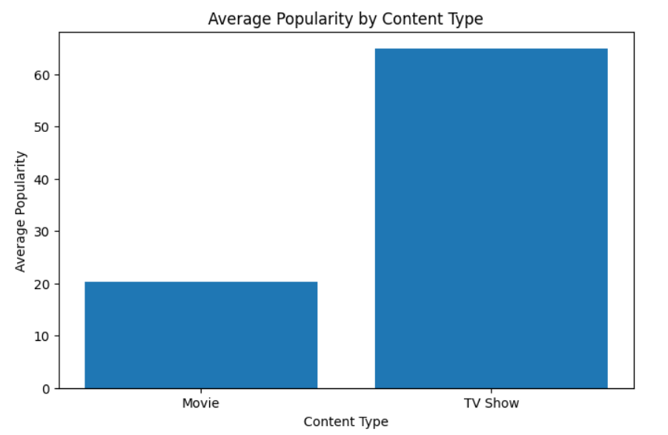
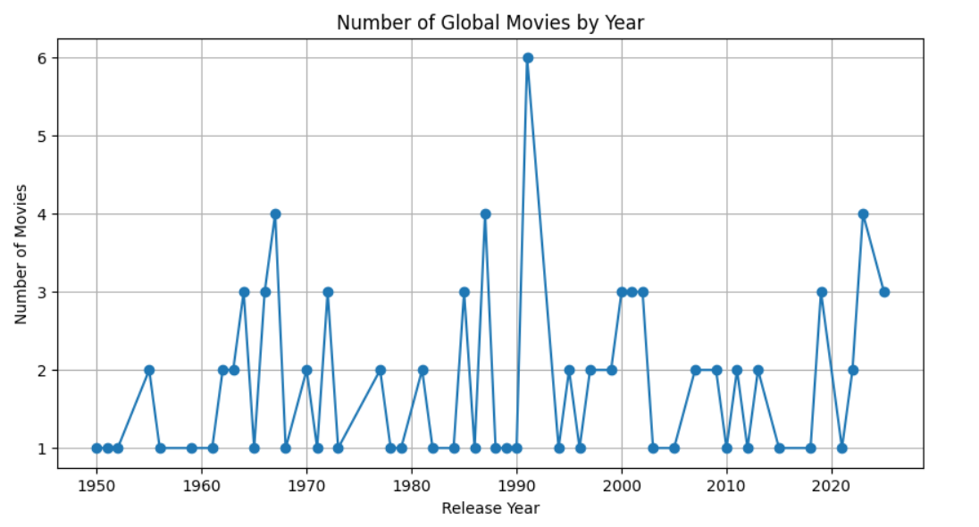
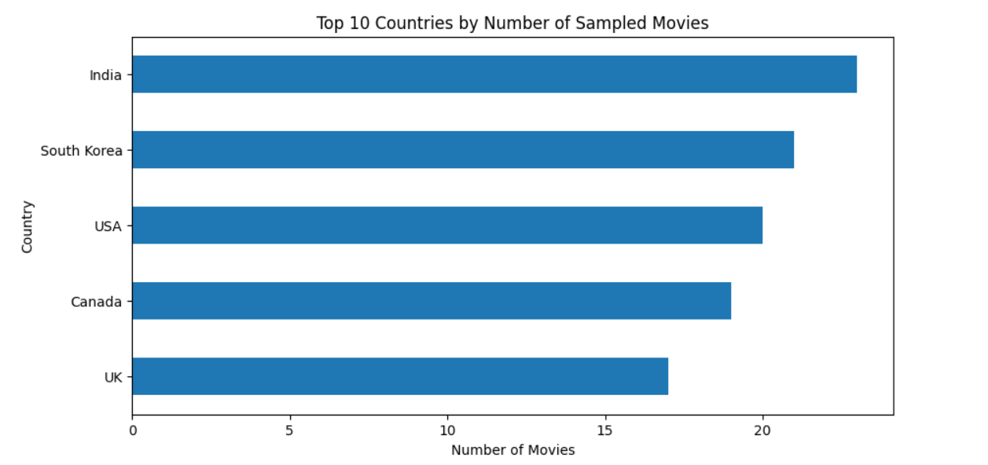
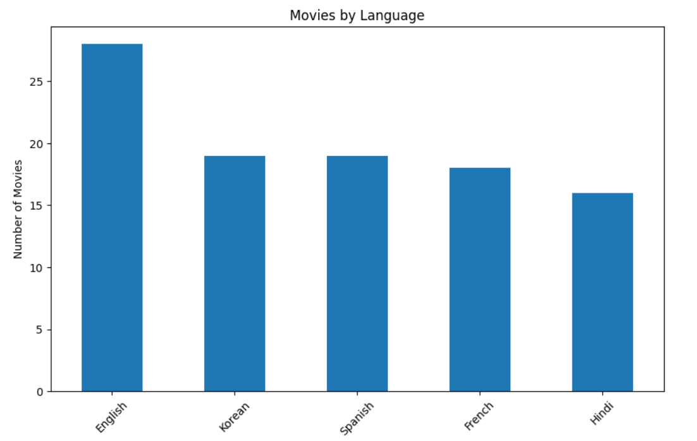
Data Visualizations
Data Visualization

Slide 13
Key Insights & Analysis
The three cleaned datasets contain a total of 34,438 OTT records.
Netflix has 31,991 records, followed by Disney+ with 1,447 and Amazon Prime with 1,000.
Netflix contains 16,000 movies and 15,991 TV shows, showing a nearly equal split.
In the Netflix dataset, Drama is the most common primary genre with 8,666 titles, followed by Comedy with 4,677.
Amazon Prime has 520 TV shows and 480 movies. Disney+ has 1,052 movies and 395 TV shows.
These patterns help us compare platforms and understand how OTT content is distributed.

Slide 14
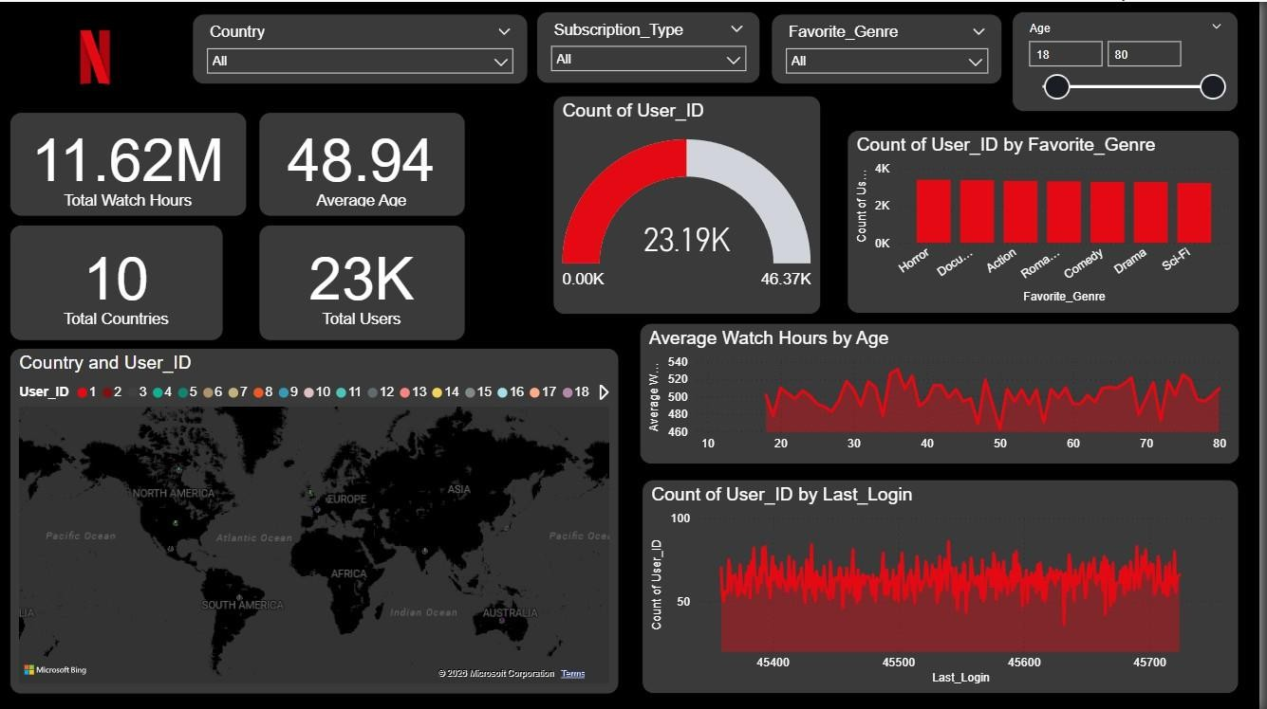
Netflix Dashboard

Slide 15
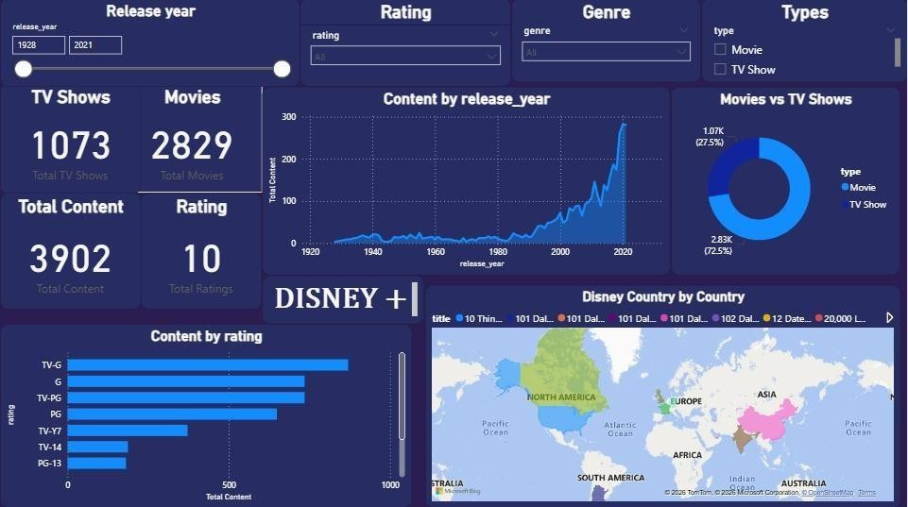
Disney + Dashboard

Slide 16
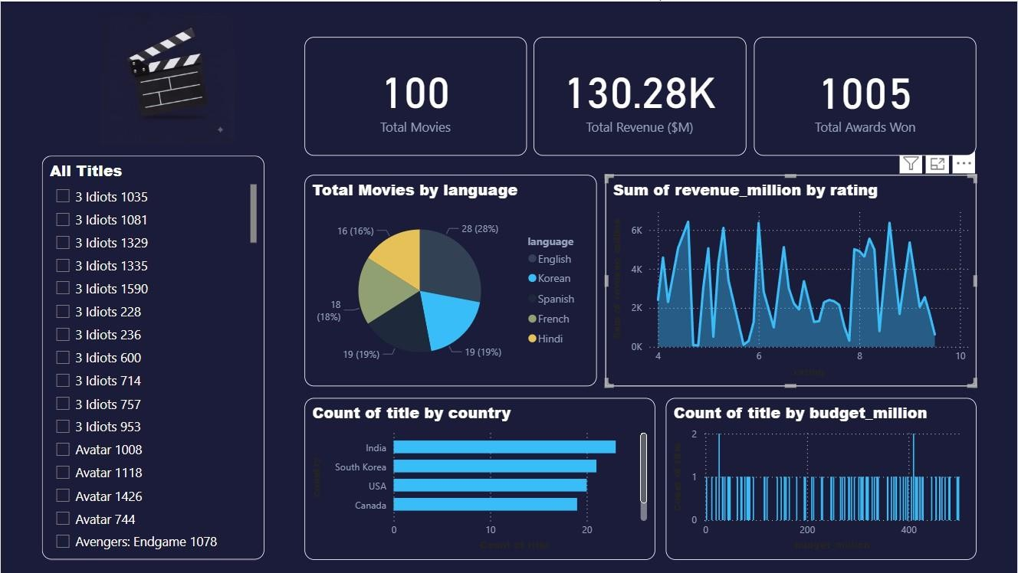
Movies Dashboard

Slide 17
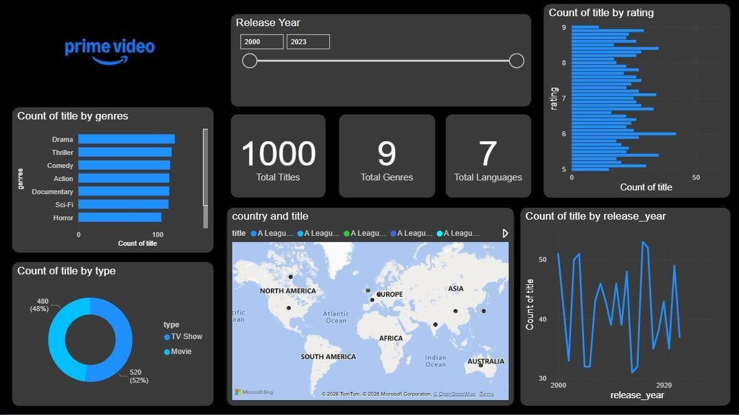
Prime Dashboard

Slide 18
Conclusion
Future Scope
This project shows how OTT datasets can be cleaned and analyzed using Python.
Add more OTT platforms and newer datasets.
Build recommendation models using machine learning.
We combined information from Netflix, Amazon Prime Video and Disney+.
The analysis helped us compare platforms, content types and genres.
Study viewer ratings, reviews and engagement in more detail.
Charts made the main patterns easier to understand.
Apply these same steps to larger datasets, live data sources, and predictive modelling.
The project also shows how data analysis can support better content-related decisions.

Slide 19
THANK YOU
Ch . Kusumitha Keerthi | Praveen Goswami | A . Aparajitha | K . Harsha Vardhan

